Slide 1
Automating a “Mega” User Journey: Relieving the pain of in- and out-processing
7 June 2022
Nick Forrest, Capt, US Air Force
Colt Whittall, CXO, US Department of the Air Force

Slide 2
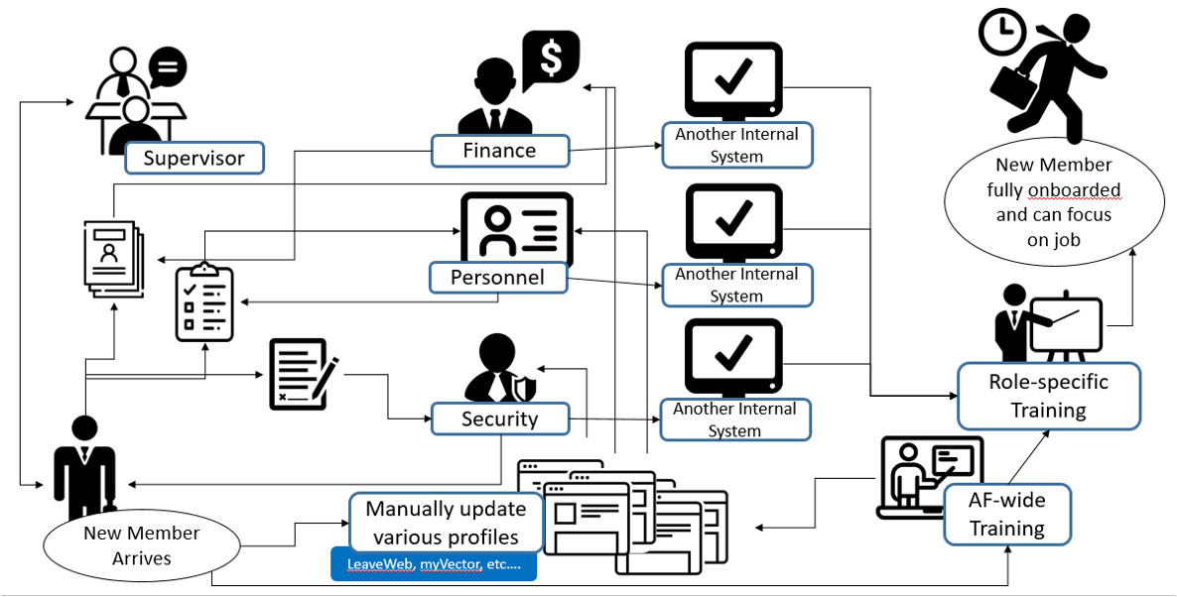
Current Onboarding Process

Slide 3


Our Journey
Aug ‘20
Feb ‘21
Sept ‘22
Won Vice Chief of Staff Digital Wingman Challenge
Won 2020 Vice Chief’s Challenge, earns senior leader support
Expected MVP launch date: delivery schedule on-time.
Apr ‘20
Oct ‘20
Oct ‘21
Horrible first-time, early-pandemic, relocation experience
Research to explore the demand for relocation solution
Funding secured to build MVP within 1 year

Slide 4
Our Challenge
Current in/out processing experiences are efficient, lack standardization, are prone to delays that waste time and money, and add unnecessary stress on our service members.
400k
44%
325
Number of service members that relocate annually. Many with families.
of servicemembers and 45% of spouses indicate relocation stress as top five career stressor.*
Avg # of people that each Air Force HR specialist manages.**
*source: 2018 RAND study on PCS-induced stress
**source: 2022 HAF Human Resources 101 Brief

Slide 5






Our Process
Emphasize Discovery & Iterate On Design
5 organizations share ownership
6 unique personas across process
71 End-Users
8 Duplicate Efforts
+
→
Ranging from UX Design internships to functioning prototypes consolidated
Collected from across various diverse bases around the United States
150 data fields across 40+ forms
189 UX features designed

Slide 6




UX
Focus
Areas
Convenience
Everything you need all in one easy-to-use tool.
Consistency
Similar process every time you PCS.
Transparency
Track your progress along the way.
Speed
Automate as much as possible to give time back.

Slide 7
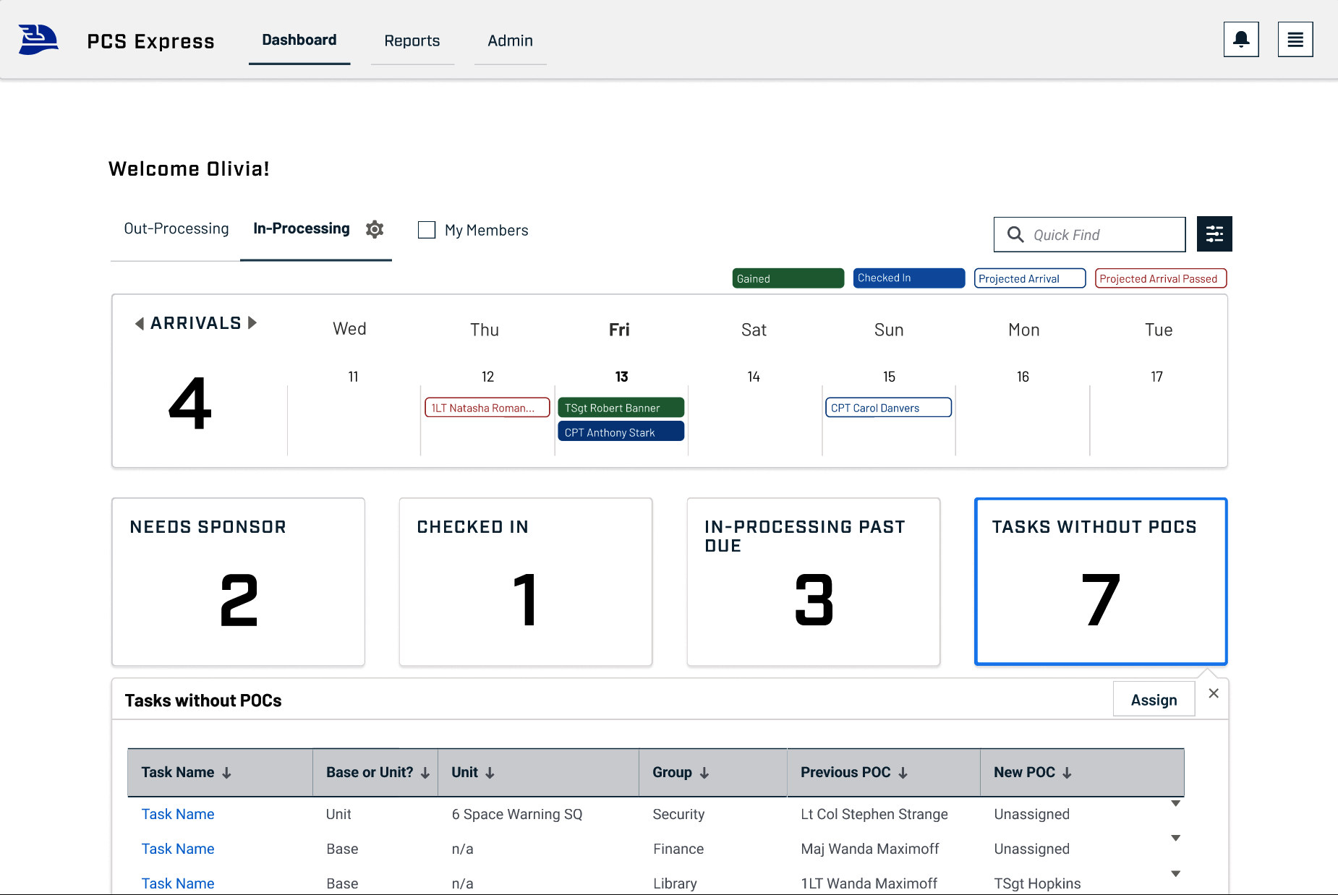
Personnel
Technician Dashboard

Slide 8
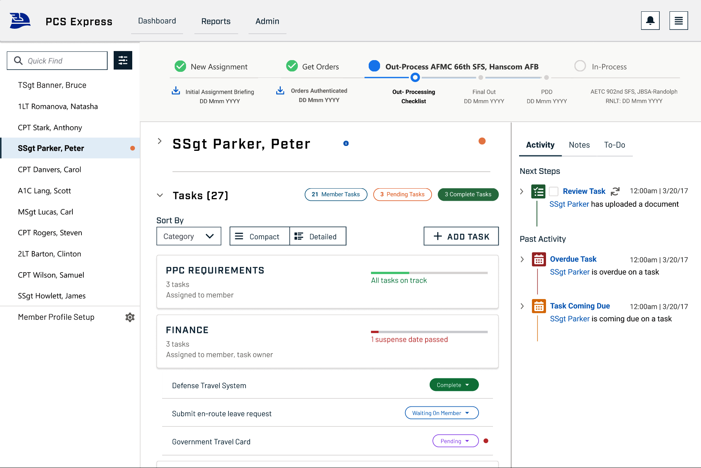
Personnel Technician Dashboard

Slide 9
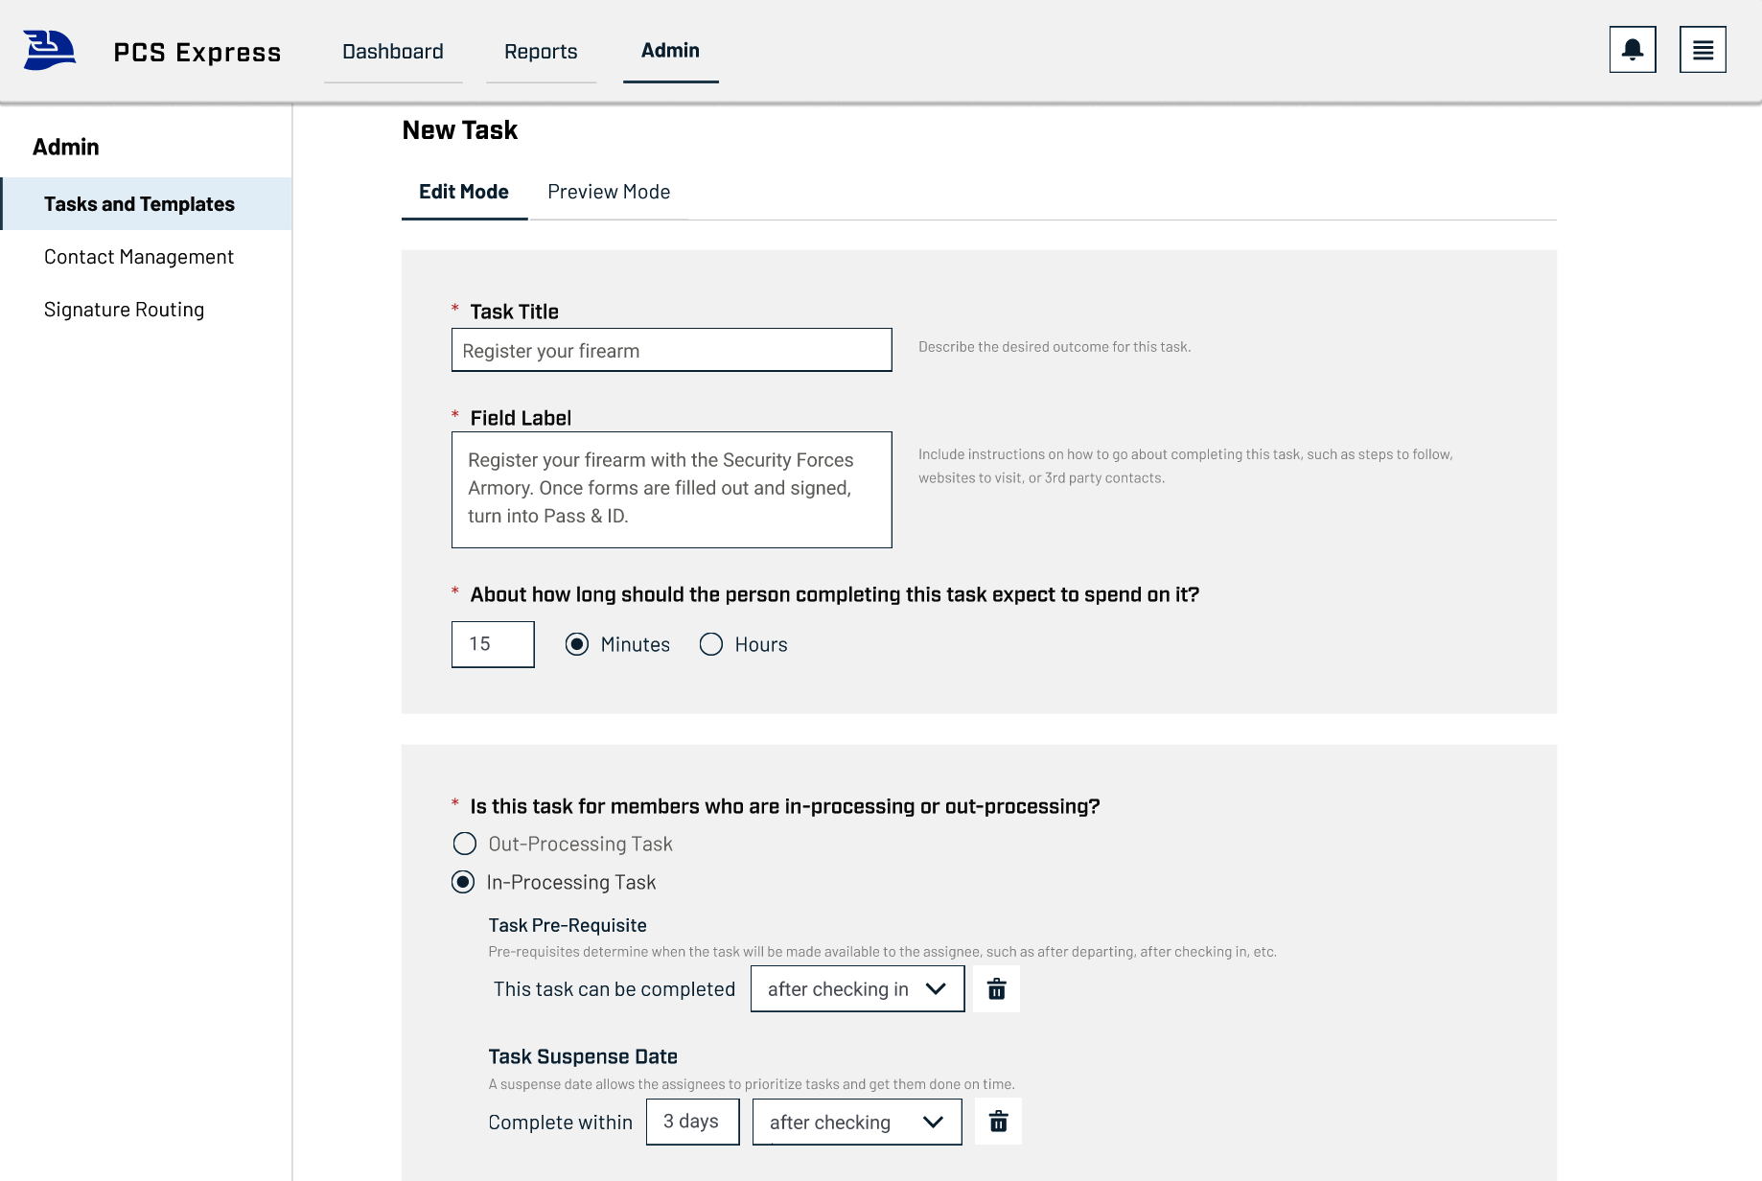
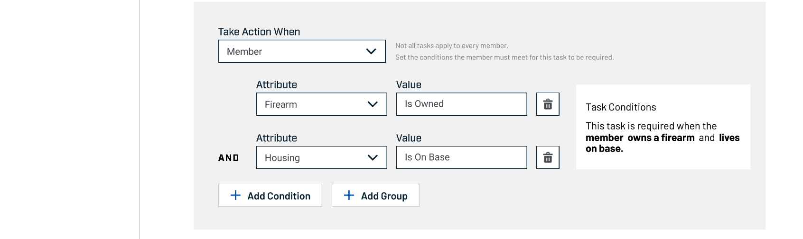
Personnel Technician Dashboard

Slide 10
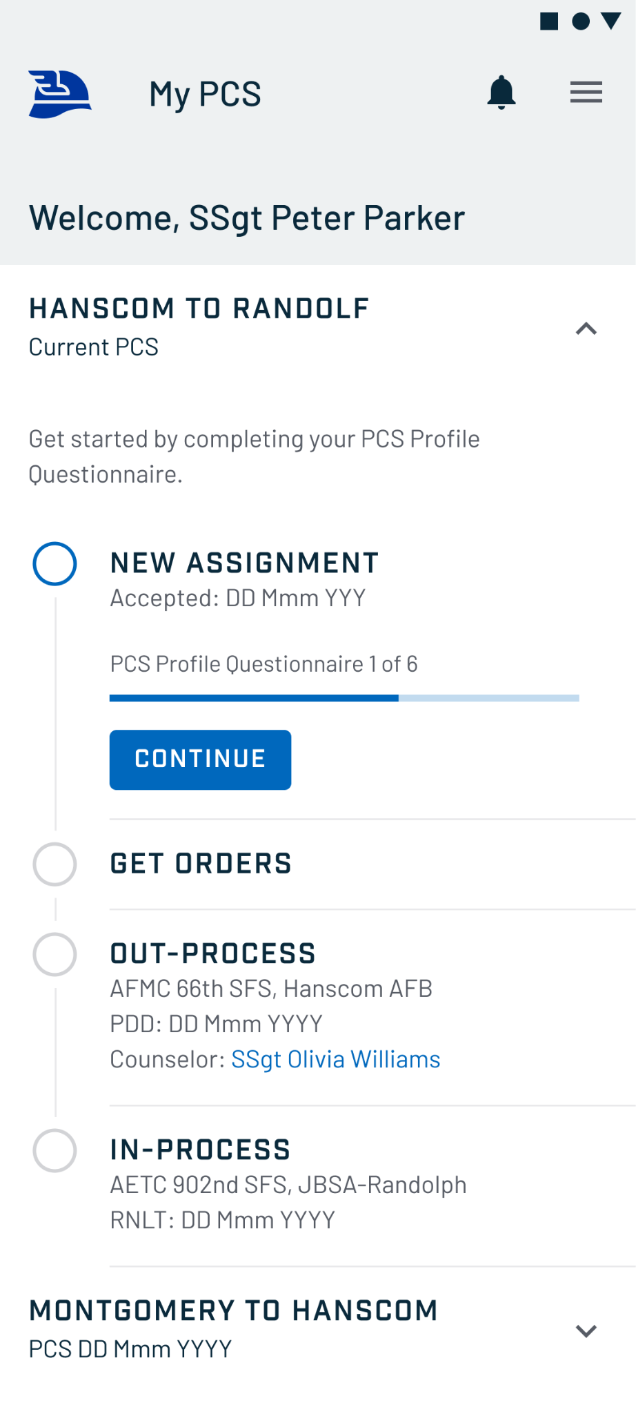
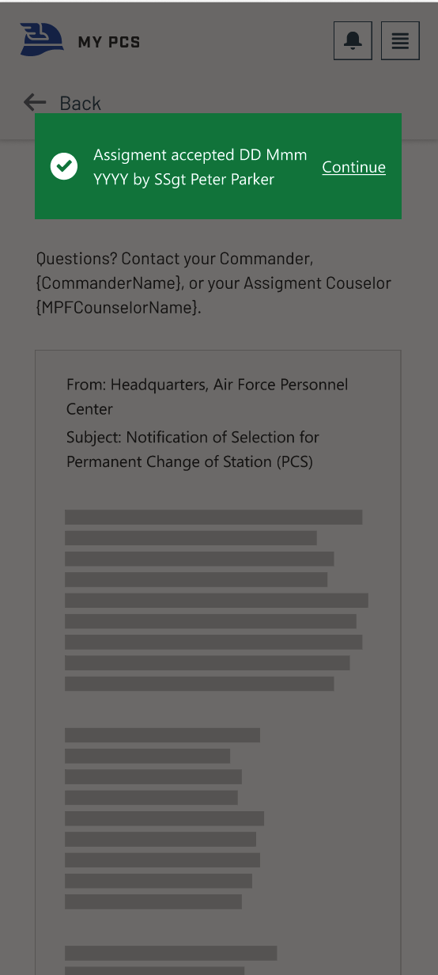
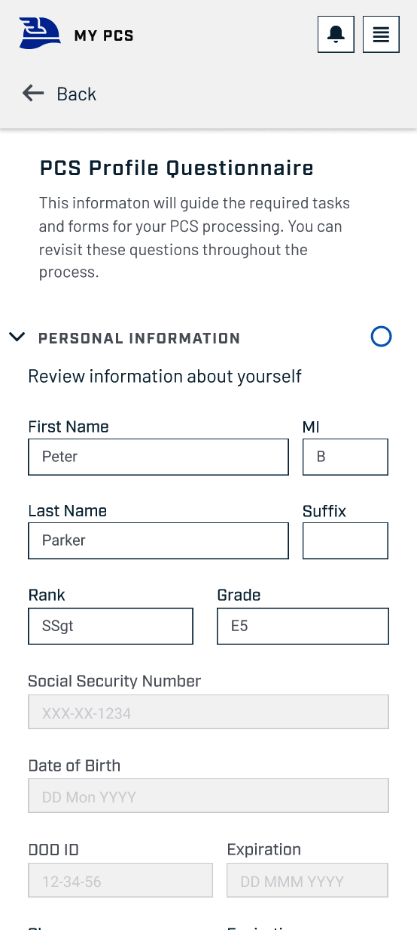
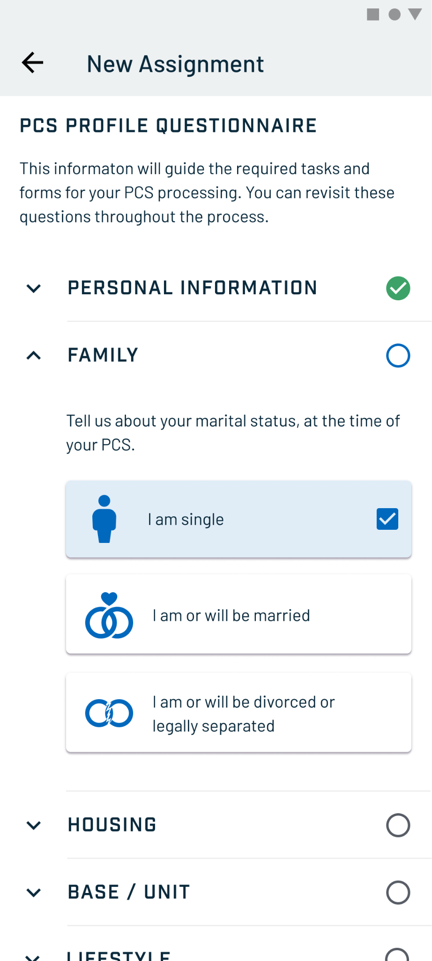
Receiving & Accepting A New Assignment
Dashboard
Accept & Sign Assignment
Questionnaire
Questionnaire

Slide 11
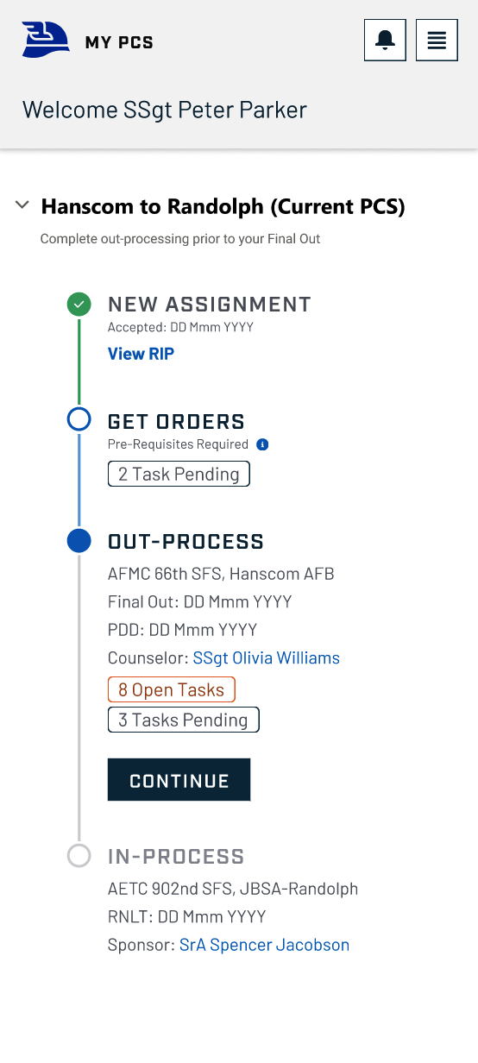
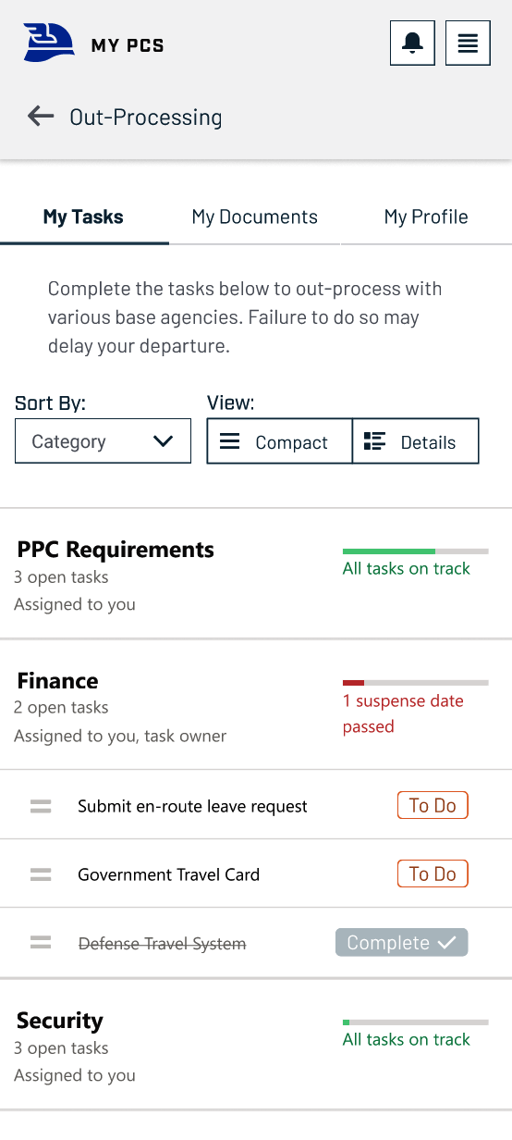
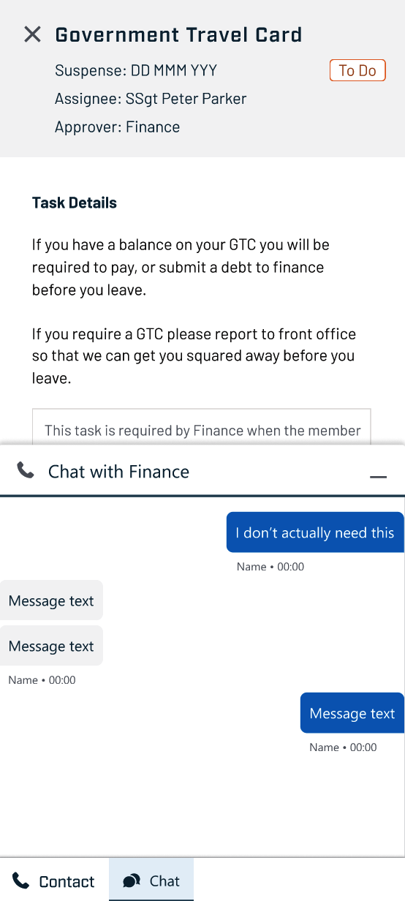
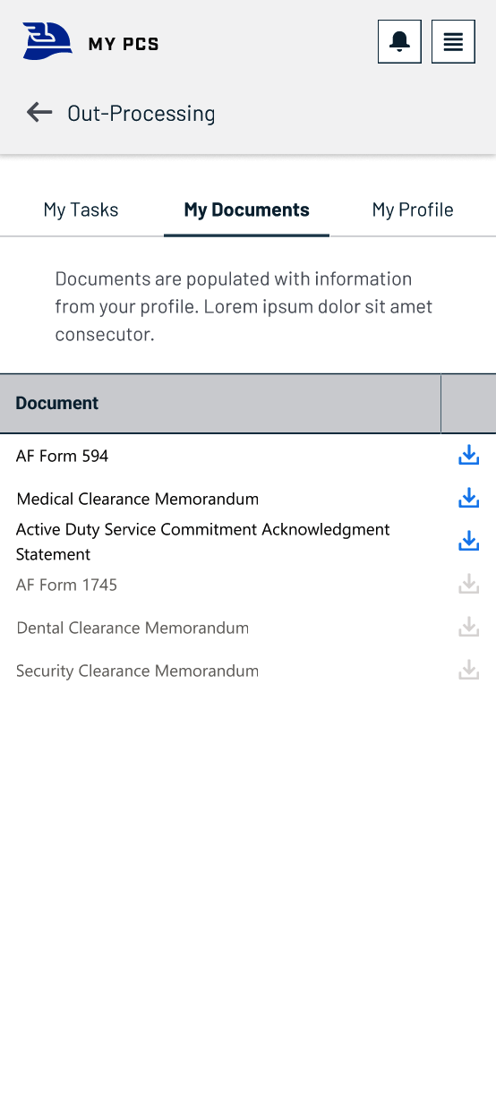
Managing and Executing Responsibilities
Dashboard
Auto-Generated To-Do List
Get Details and Direct Chat
Auto-populate & Store Docs

Slide 12
QUESTIONS?
Nick Forrest, Capt, USAF
AI Solutions Architect, Air Force Futures
nicholas.forrest.4@us.af.mil
Mr. Colt Whittall, HQE
CXO, Department of the Air Force
lloyd.whittall.1@us.af.mil

